Slide 1
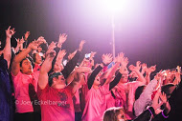
Faculty Focus October, 2015
MCHS TRIBE on NEON NIGHT! GO INDIANS!
Picture by: Joey Ecklebarger

Slide 2
Reminders and Information
Professional Learning Day—Lesson Plans— Thursday during planning periods in Collab. Lab
Faculty Meeting—Thursday, 3:20 in Auditorium
TKES Formative #1 will begin the week of October 27th.
Professional Learning Day w/ DOE—Differentiation Mrs. Ford will post details on the weebly.
Oct. 20: Social Studies a.m./ELA p.m. (Subs provided)
Nov. 13: Math a.m./Science p.m. (Subs provided)

Slide 3
Certified Absences Goal: < 400

Slide 4
Students Missing More than 5 Days 2014: 51.2% 2015 Goal: < 40%

Slide 5
Discipline Goal: < 350

Slide 6
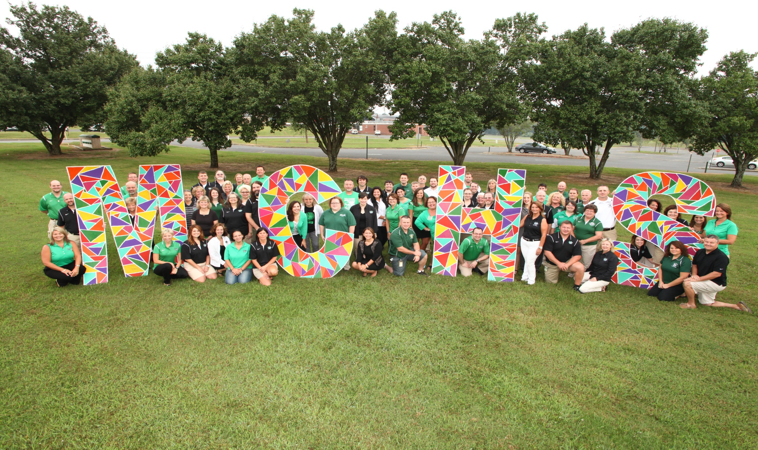
Don’t forget to comment on the WEEBLY!
HANG IN THERE!!!!

