Slide 1
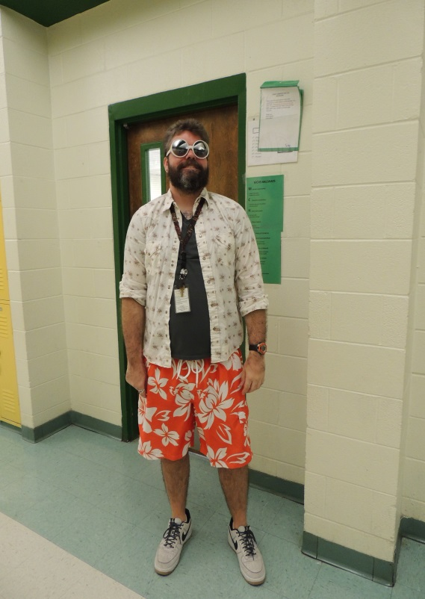
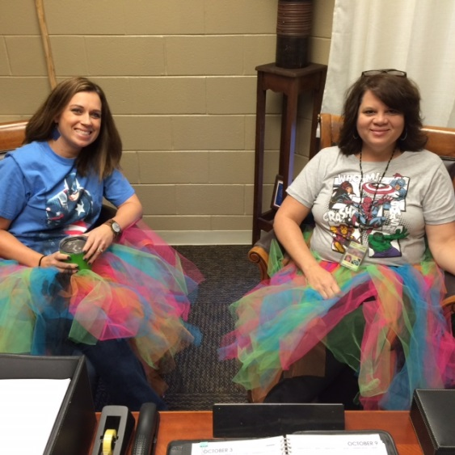
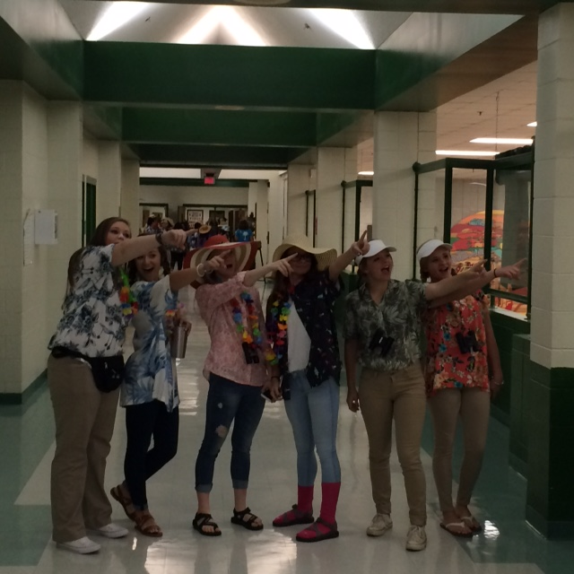
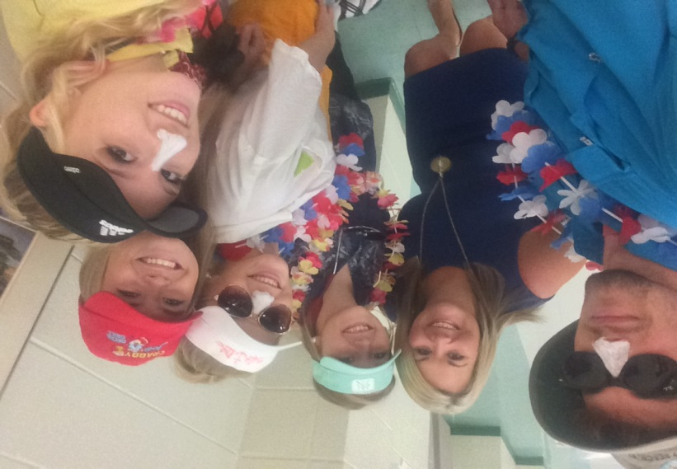
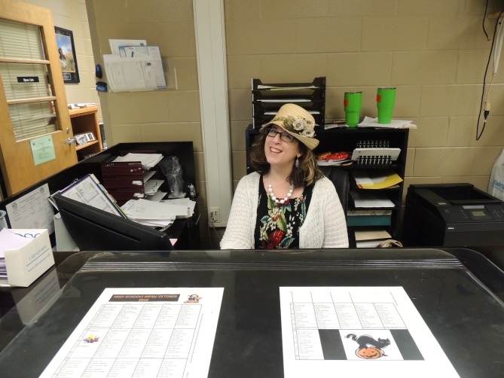
Faculty Focus September, 2016

Slide 2
Faculty and Staff, This year, I have organized parts of the Faculty Focus into our four FOCUS AREAS. The information included will not cover everything we are implementing and monitoring for each Focus Area, but it will assist us in monitoring progress toward our goals.

Slide 3
UPDATES/REMINDERS
Power School Webinar—Wednesday, Oct. 5th. Mandatory attendance for all Core Academic teachers.
Homecoming Parade Friday—we have a faculty float again this year. You need to plan to ride it if you are not supervising students on another float.
Homecoming Game Friday—we hope to see everyone there!
Homecoming Dance Saturday—8:00 – 11:00. 9th Grade Advisors chaperone. If you have made arrangements to change dance responsibilities with someone, you should have already notified Mrs. Linder.
MONDAY, October 10th, is a HOLIDAY!!!!
Faculty Meeting—October 12th.

Slide 4
FOCUS AREA
Faculty Leadership and Positive Focus

Slide 5
Certified Absences Goal: < 400

Slide 6
FOCUS AREA
Student Attendance

Slide 7
Students Missing More than 5 Days

Slide 8
Monthly Student Attendance Missing more than 5 days 2017 Goal: <50%

Slide 9
Discipline—Student Referrals Goal: < 300

Slide 10
FOCUS AREA
IMPROVE LITERACY

Slide 11
SRI Data % Proficient and Advanced

Slide 12
FOCUS AREA
INCREASE RIGOR
We are working on our PLCs for this Focus Area. In the meantime, ask lots of “WHY” questions and engage ALL students in critical thinking tasks.

Slide 13
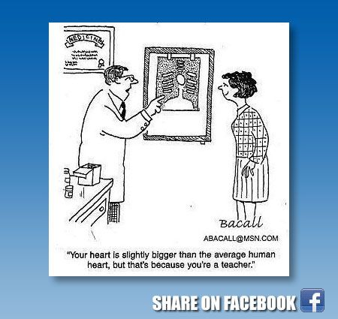
Remember to post a comment on the weebly!

